Slide 1
Developing with the Brightcove Mobile SDKs
(name), Learning Specialist
training@brightcove.com

Slide 2
Agenda
Introducing the Course
Overview
Understanding the iOS SDK
QuickStart for iOS
Understanding the Android SDK
QuickStart for Android
2

Slide 3
Introducing the Course

Slide 4
What are the mobile sdks?
An API for accessing the content and metadata in your Brightcove account
API (Application Programming Interface)
Read requests allow you to search for videos or playlists
Write requests allow you to add, update, and delete videos and playlists
4
Notes:
4
Started at 3:04

Slide 5
why use the mobile sdks?
Many examples in the Developer Documentation
http://docs.brightcove.com/en/video-cloud/media/index.html
5

Slide 6
who can use the mobile sdks?
The Media API Read methods are available in the following editions
Express 3
Professional
Enterprise
The Media API Write methods are available in
Professional
Enterprise
You can use any programming language that than can make HTTP calls to work with the Media API
JavaScript is used in this course
6

Slide 7
course Audience and Prerequisites
Designed for developers, or project managers who want to understand the capabilities of the Media API
Some knowledge of HTML and some scripting/programming language will allow you to optimally benefit from the course
7

Slide 8
Overview

Slide 9
Brightcove Player SDK Support

Slide 10
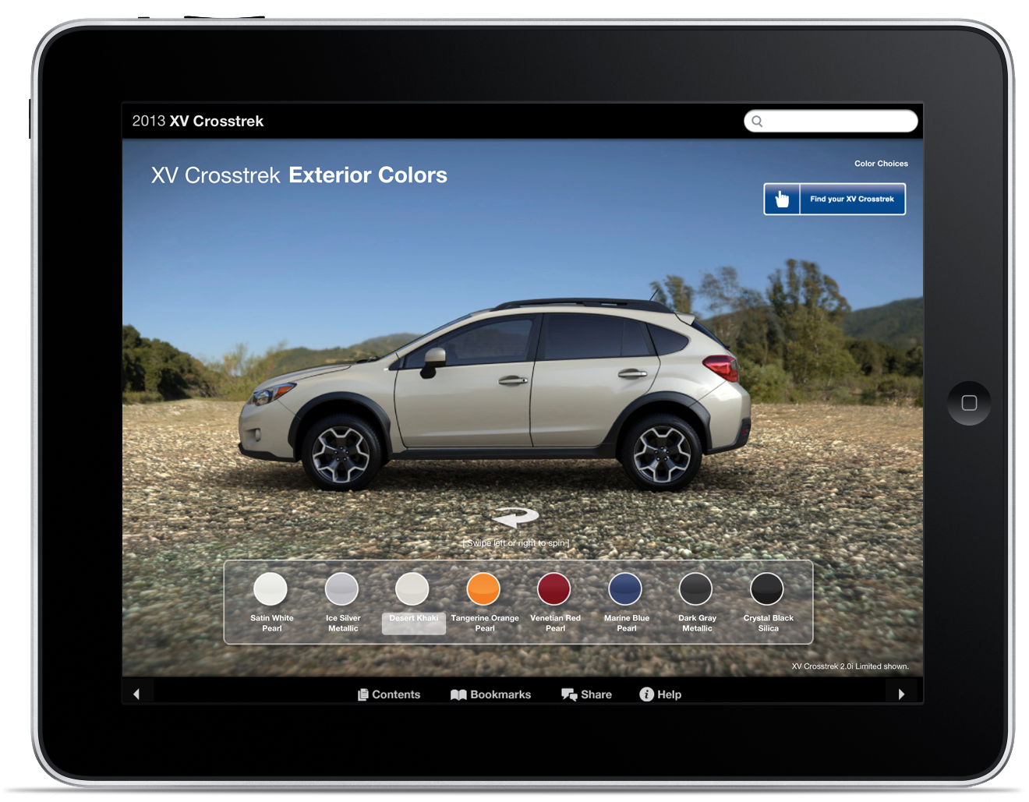
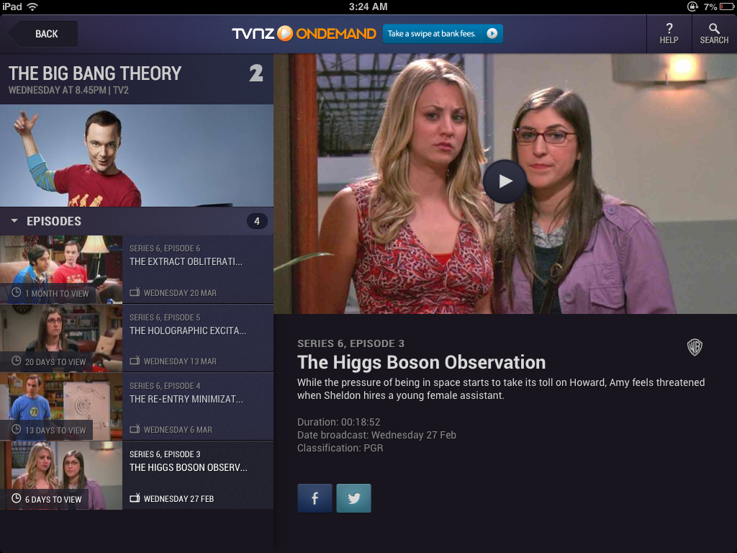
Fundamentals of the Brightcove Player SDK
DIY
Brightcove
4 different SDKs and points of integration
1 SDK that provides support for all 4 functions
Custom UX
Custom UX
Analytics
Brightcove
SDKs
(Android & iOS)
DRM
Advertising
Media API
Built-in Platform Player
Built-in Platform Player

Slide 11
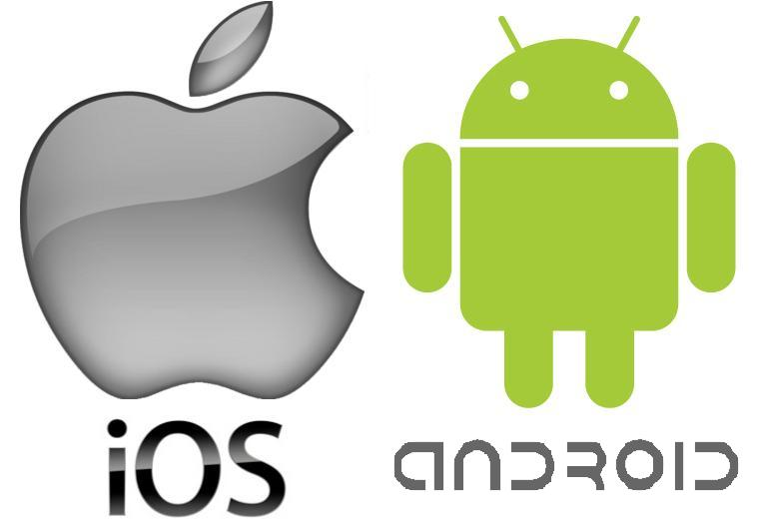
High level architectural view of BC SDKs’ fit within the device software
iOS App
BrightcoveVideoView replaces the native Android VideoView
BrightcoveVideoView is a system level alternative to the BrightcovePlayer
View Controller
Entry point to the BC Player SDK for iOS
BCOVPlayerSDKManager
Android App
create
BCOVPlaybackController
BrightcovePlayer
EventLogger
View
delegation
MediaController
UIView
BCOVPlaybackSession
view
BrightcoveVideoView
EventEmitter
Metadata, prepare and playback
AVPlayerLayer
Presents video on screen
Presents video on screen
native code
Using the BC Player in the SDK auto updates BC analytics in the VC
Data collection API may be used to send analytics data to VC without using the BC Player
BC fundamentally uses the AV foundation.
HLS support is whatever is made available by the AV foundation.
BC SDK code

Slide 12
Understanding the iOS SDK

Slide 13
Limiting Response Size by field name
Reasons to limit response size
Less bandwidth, better performance
Only request the metadata you need
Limit response size by using the video_fields parameter
A comma separated list of fields to include in the response data
Syntax
video_fields=id,name,…
playlist_fields=id,name,…
Some data fields are only returned when specifically requested
13

Slide 14
Demo 5: Limiting Response Size
14
Notes:
14

Slide 15
Topics review
Introducing the Course
Setting Up
Understanding the Media API
Using Read Methods (Constructing requests, parsing returned data)
Controlling Responses (Limiting response size, sorting and paging)
Using Write Methods
Using Server-Side Calls
15

Slide 16
Thank you

